Slide 1
CSCE 623 In Class Day 3
Concept Test Review

Slide 2
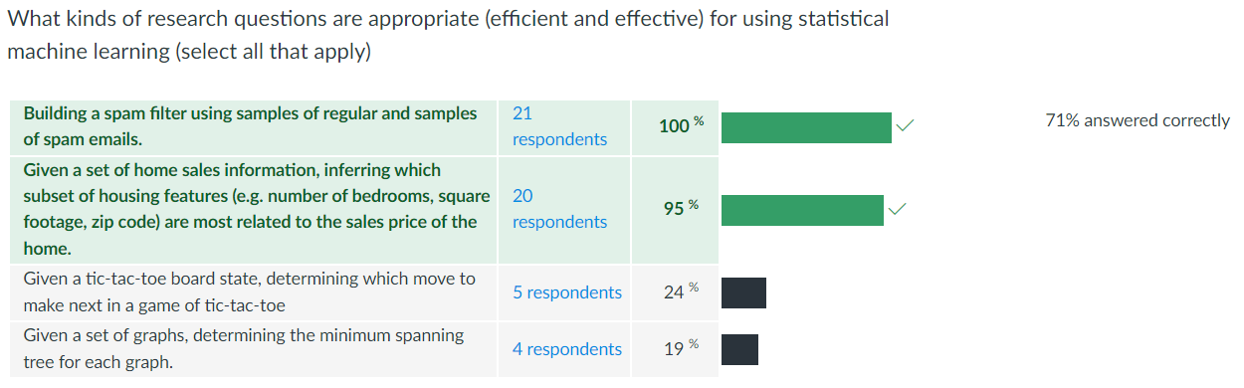
Q3: Good & Bad ways to use SML
Why isn’t statistical machine learning appropriate in these instances?

Slide 3
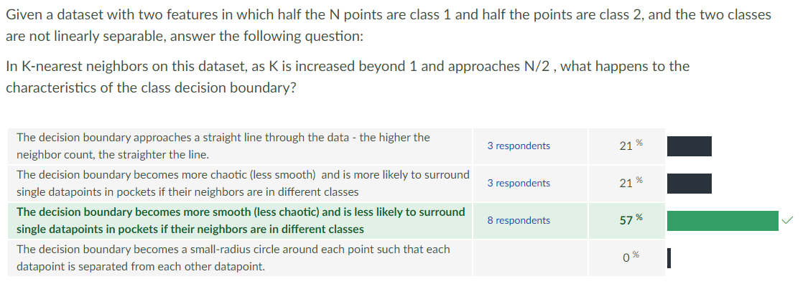
Q4: what's really happening in KNN? (1/2)

Slide 4
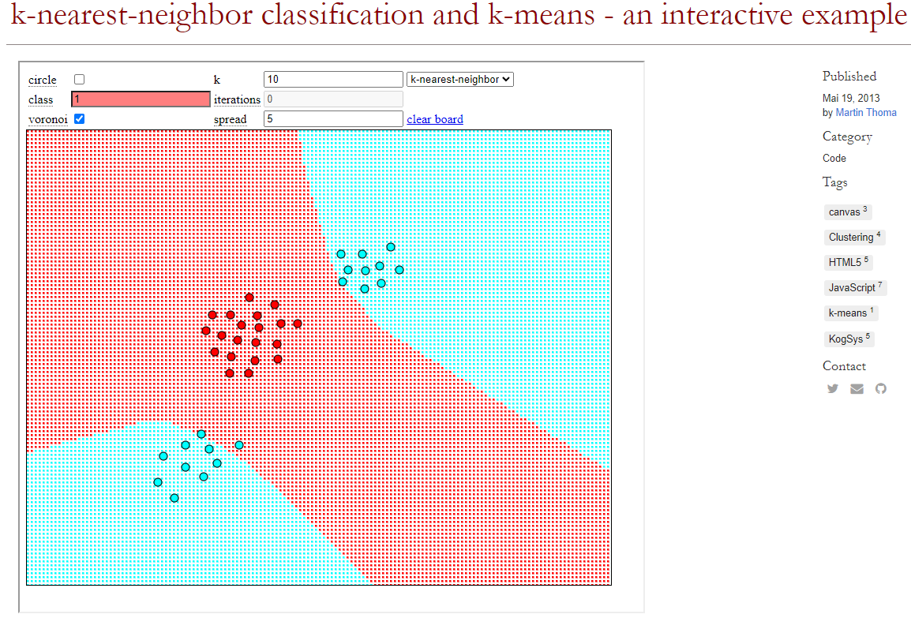
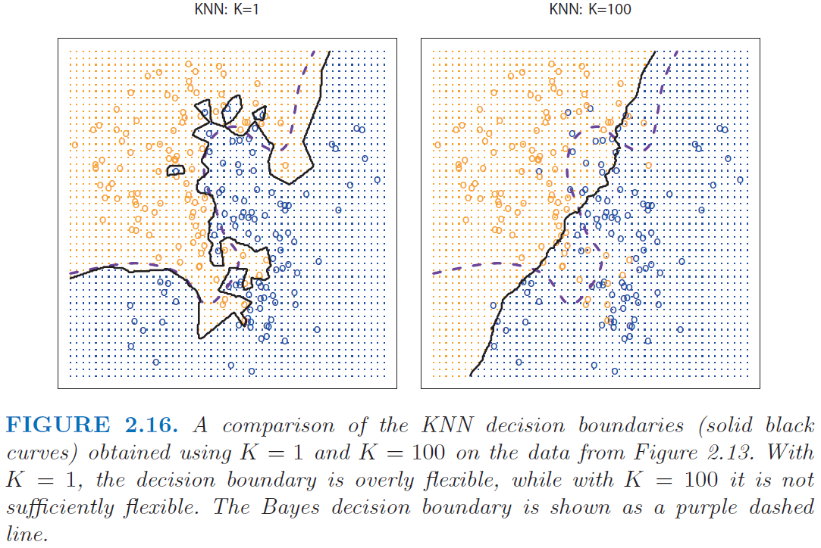
Q4: what's really happening in KNN? (2/2)
https://martin-thoma.com/k-nearest-neighbor-classification-interactive-example/

Slide 5
Questions?

